Slide 1



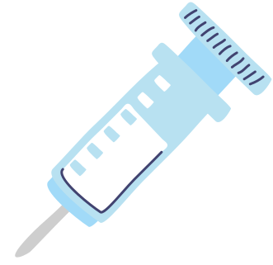

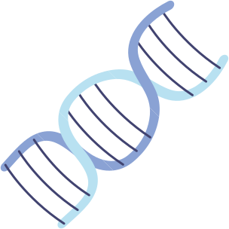




Created By : JANANI
SMART HEALTH AND WELLNESS MONITORING SYSTEM

Slide 2
Introduction
Exploration of innovations in medicine
This is the smart health monitoring system designed that allows users to track and manage their health metrics in real-time.
Greetings and introduction
The system will leverage wearable device data to monitor vital signs, physical activity, and wellness indicators, offering personalized health insights through visualizations and insights.

Slide 3
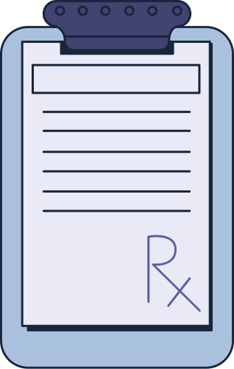
Project Overview :
REGISTRATION for the new user to access the application.
LOGIN for the customer to access the total features of the application.
ADMIN DASHBOARD to view the details of doctors availability for the user.
Administrator Features
HEALTH INSIGHTS to analyze health data to generate personalized insights.
WELLNESS TRACKING SYSTEM to implement features for setting and tracking wellness goals,monitoring and managing the expenses spent on the health i.e. food or fitness.
Customer Features

Slide 4
Milestone:
User Authentication
Health Data Collection
Implement registration, login, and logout using Django REST Framework.
Configure token-based authentication.
Integrate wearable device APIs (e.g., Fitbit, Apple Health).
Implement data syncing and retrieval endpoints.
Wellness Goals and Tracking
Dashboard Visualization & Admin Panel
Implement goal setting, tracking, and notifications.
Use visualization libraries for health data.
Develop admin panel for user and system management.

Slide 5

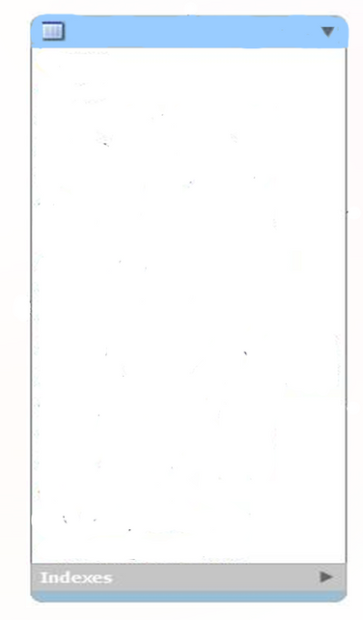
Class Diagram
Notification
notification_id
user_id
Message
notification_type
timestamp
User
Goal
user_id
Username
email
password
date_of_birth
gender
profile_picture
goal_id
user_id
goal_type
target_value
current_value
start_date
end_date
set_goal()
update_progress()
check_goalachieve
send_notification()
schedule_reminder()
HealthInsight
insight_id
user_id
insight_text
recommendation
generated_on
generat_insights()
send_alert()
register()
login()
logout()
update_profile() view_health_metrics()
HealthData
data_id
user_id
timestamp
heart_rate
blood_pressure
steps
calories_burned
sleep_duration
collect_data()
sync_data()
retrieve_data()
SystemPerformance
performance_id
system_uptime
user_count
active_sessions
data_sync_status
monitor_performance()
generaye_report()
Admin
admin_id
username
email
passwod
manage_user_accounts()
view_system_performance()
monitor_health_metrics()
Notes:
5

Slide 6
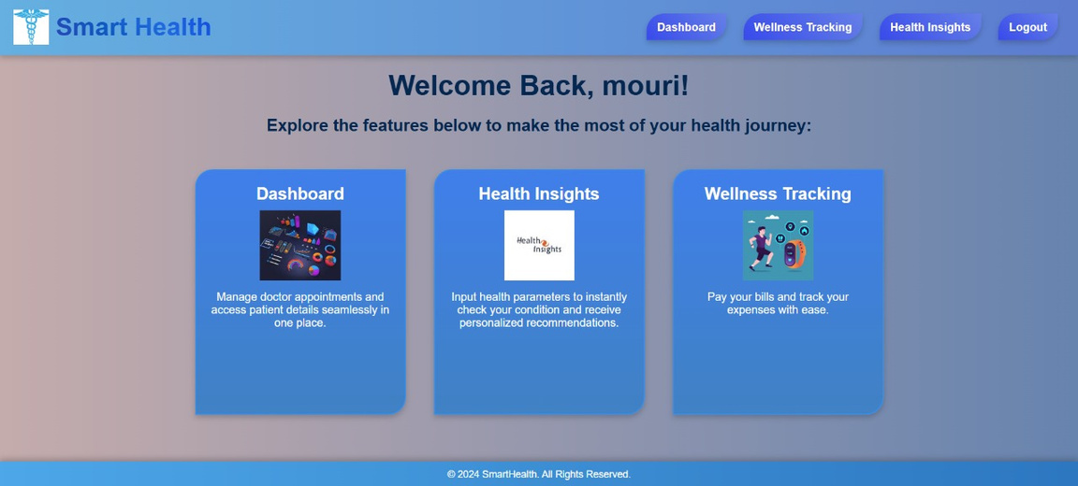
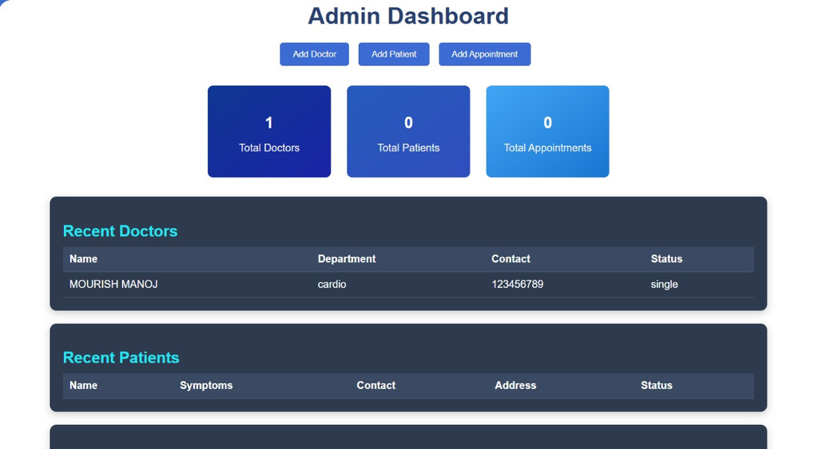
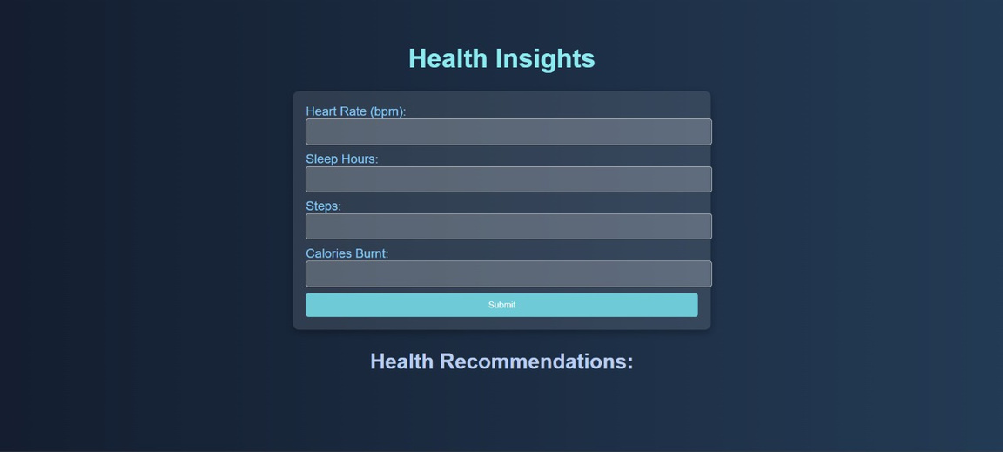
SCREENSHOTS

Slide 7
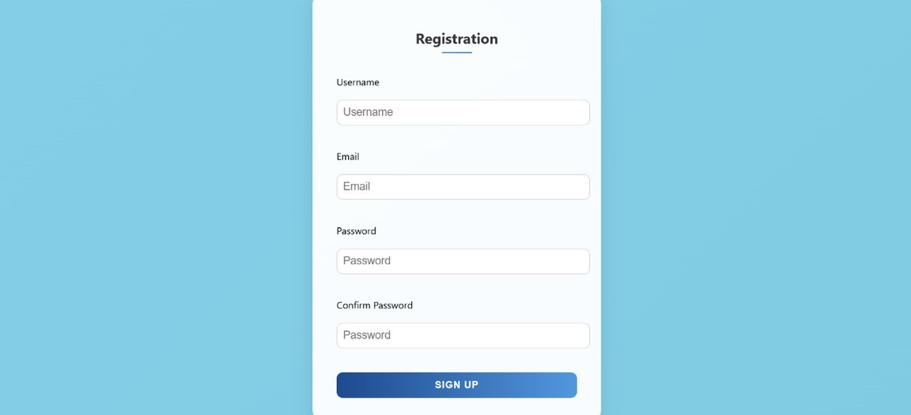
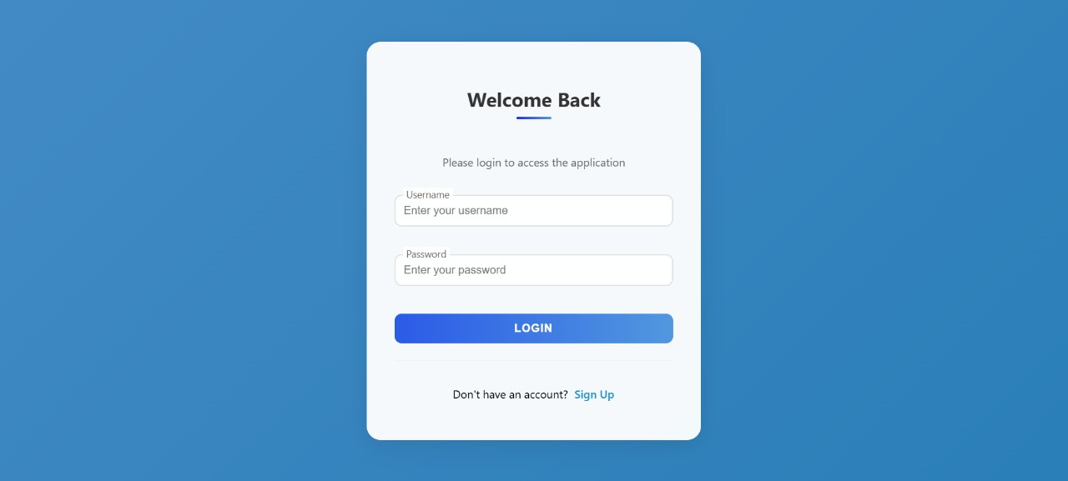

Slide 8
Conclusion
Summarizing key points discussed
Data-Driven Insights
By combining advanced technology, personalized analytics, and a user-centric approach, the Smart Health and Wellness Monitoring System revolutionizes the way individuals manage their health and well-being. This innovative platform empowers users to take control of their personal health, while also enabling healthcare professionals to deliver more effective, data-driven care and support.
Healthcare professionals can leverage the system's robust data analytics capabilities to gain valuable insights, optimize patient care, and make data-driven decisions that improve overall health outcomes.

Slide 9
Thank you for your attention

